Slide 1
Remote Invocation

Slide 2
Contents
Processes/objects/components/services communication via remote invocation
Distributed Systems Communication
Request-reply protocol of message passing
Remote Procedure Call (RPC)
Remove Method Invocation (RMI)

Slide 3
Processes/objects/components/services communication via remote invocation
The RMI (Remote Method Invocation) is an API that provides a mechanism to create distributed application in java.
The RMI allows an object to invoke methods on an object running in another JVM.

Slide 4
Processes/objects/components/services communication via remote invocation: Middleware layers for communication
Layer 4: Applications
Layer 3: Remote invocation, indirect communication
Layer 2: Inter process communication primitives: Sockets, message passing, multicast support, overlay networks
Layer 1: User Datagram Protocol (UDP) and Transmission Control Protocol (TCP)

Slide 5
Middleware
A systems software that resides between the applications and the underlying operating systems, network protocol stacks, and hardware.
Its primary role is to
1. Functionally bridge the gap between application programs and the lower-level hardware and software infrastructure in order to coordinate how parts of applications are connected and how they interoperate.
2. Enable and simplify the integration of components developed by multiple technology suppliers.

Slide 6
Distribution Middleware
Defines higher-level distributed programming models whose reusable APIs and components automate and extend the native OS network programming capabilities encapsulated by host infrastructure middleware.
Enables clients to program distributed applications much like stand-alone applications, i.e., by invoking operations on target objects without hard-coding dependencies on their location, programming language, OS platform, communication protocols and interconnects, and hardware.
The OMG's Common Object Request Broker Architecture (CORBA) which is an open standard for distribution middleware that allows objects to interoperate across networks regardless of the language in which they were written or the platform on which they are deployed.

Slide 7
CORBA
What if the two computers use different representation for data (integers, chars, floating point)?
The most elegant and flexible solution is to have a standard representation used for all values sent through the network; the proxy and skeleton convert to/from this representation during marshalling/ unmarshalling.

Slide 8
CORBA
Who generates the classes for proxy and skeleton?
In advanced middleware systems (e.g. CORBA) the classes for proxies and skeletons can be generated automatically.
Given the specification of the server interface and the standard representations, an interface compiler can generate the classes for proxies and skeletons.

Slide 9
The request-reply protocol
Support low-level client-server interactions.
Usually synchronous and reliable
Built on top of send and receive operations
Usually use UDP datagrams, could use TCP streams
Three primitives
doOperation by clients to invoke remote op.; together with additional arguments; return a byte array. Marshaling and unmarshaling!
getRequest by server process to acquire service requests; followed by
sendReply send reply to the client

Slide 10
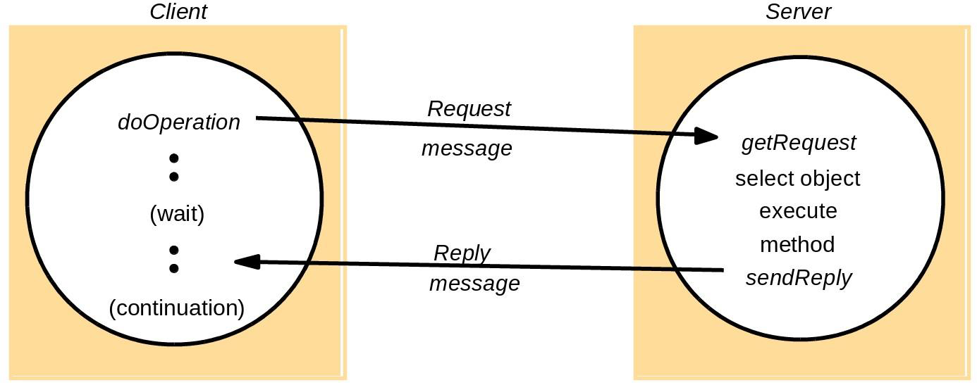
The request-reply protocol

Slide 11
Operations of the request-reply
public byte[] doOperation (RemoteRef s, int operationId, byte[] arguments)
sends a request message to the remote server and returns the reply.
The arguments specify the remote server, the operation to be invoked and the arguments of that operation.
public byte[] getRequest ()
acquires a client request via the server port.
public void sendReply (byte[] reply, InetAddress clientHost, intclientPort)
sends the reply message reply to the client at its Internet address and port.

Slide 12
Request-reply message structure
MessageType
requestId
remoteReference
operationId
arguments
int (0=Request, 1= Reply)
Int
RemoteRef
int or Operation
array of bytes

Slide 13
Request-reply protocols (cont.)
Message identifiers must identify request uniquely:
requestId: usually a sequence counter (makes unique at client)
Client/sender identifier endpoint (with requestId, globally unique)
Failure model
Over UDP: omission, misordering
Over UDP or TCP: server crash failure
Timeouts: doOperation uses when blocked for reply
Duplicate request msgs: server may get >1 times

Slide 14
Example of Request-reply protocol
An example of how to use messaging, implemented in Java Message Service (JMS).
JMS API is a messaging standard that allows application components based on the Java Platform Enterprise Edition (Java EE) to create, send, receive, and read messages.
It enables distributed communication that is loosely coupled, reliable, and asynchronous.

Slide 15
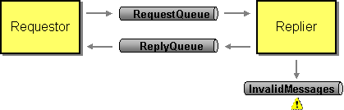
JMS Request/Reply Example
It shows how to implement request-reply, where a requestor application sends a request, a replier application receives the request and returns a reply, and the requestor receives the reply.
It also shows how an invalid message will be rerouted to a special channel.

Slide 16
JMS Request/Reply Example
Two main classes:
Requestor — A Message Endpoint that sends a request message and waits to receive a reply message as a response.
Replier — A Message Endpoint that waits to receive the request message; when it does, it responds by sending the reply message.
The Requestor and the Replier will each run in a separate Java virtual machine (JVM), which is what makes the communication distributed.
This example assumes that the messaging system has these three queues defined:
jms/RequestQueue — The Queue the Requestor uses to send the request message to the Replier.
jms/ReplyQueue — The Queue the Replier uses to send the reply message to the Requestor.
jms/InvalidMessages — The Queue that the Requestor and Replier move a message to when they receive a message that they cannot interpret.

Slide 17
JMS Request/Reply Example
When the Requestor is started in a command-line window, it starts and prints output like this:
Sent Request:
NB: (This shows is that the Requestor has sent a request message.
Notice that this works even though the Replier isn't even running and therefore cannot receive the request.)
request Time: 1048261736520 ms
Message ID: ID:_XYZ123_1048261766139_6.2.1.1
Correl. ID: null (Correlation id)
Reply to: com.sun.jms.Queue: jms/ReplyQueue
Contents: Hello world.

Slide 18
JMS Request/Reply Example
When the Replier is started in another command-line window, it starts and prints output like this:
Received Request:
Sent Reply
request Time: 1048261766790 ms
Message ID: ID:_XYZ123_1048261766139_6.2.1.1
Correl. ID: null (Correlation id)
Reply to: com.sun.jms.Queue: jms/ReplyQueue
Contents: Hello world.
request Time: 1048261766850 ms
Message ID: ID:_XYZ123_1048261758148_5.2.1.1
Correl. ID: ID:_XYZ123_1048261766139_6.2.1.1
Reply to: null
Contents: Hello world.

Slide 19
JMS Request/Reply Example
This shows that the Replier received the request message and sent a reply message.
Four interesting points to notice in this request and reply messages.
First, notice the request send and received timestamps; the request was received after it was sent (30270 ms later).
Second, notice that the message ID is the same in both cases, because it's the same message.
Third, notice that the contents, "Hello world," are the same, which is very good because this is the data being transmitted and it has got to be the same on both sides.
The queue named "jms/ReplyQueue" has been specified in the request message as the destination for the reply message (an example of the Return Address pattern).

Slide 20
JMS Request/Reply Example
Comparing the output from receiving the request to that for sending the reply.
Five points to be noticed:
First, the reply was not sent until after the request was received (60 ms after).
Second, the message ID for the reply is different from that for the request; this is because the request and reply messages are different, separate messages.
Third, the contents of the request have been extracted and added to the reply.
Forth, the reply-to destination is unspecified because no reply is expected (the reply does not use the Return Address pattern).
Fifth, the reply's correlation ID is the same as the request's message ID.

Slide 21
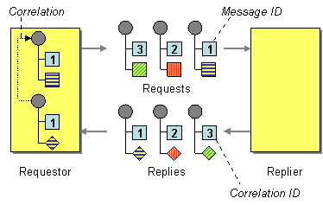
JMS Request/Reply Example
Correlation Identifier
How does a requestor that has received a reply know which request this is the reply for?
Each reply message should contain a Correlation Identifier, a unique identifier that indicates which request message this reply is for.

Slide 22
JMS Request/Reply Example
Finally, back in the first window, the requester received the reply:
Received reply
request Time: 1048261797060 ms
Message ID: ID:_XYZ123_1048261758148_5.2.1.1
Correl. ID: ID:_XYZ123_1048261766139_6.2.1.1
Reply to: null
Contents: Hello world.
The reply was received after it was sent (30210 ms).
The message ID of the reply was the same when it was received as it was when it was sent, which proves that it is indeed the same message.
The message contents received are the same as those sent.
The correlation ID tells the requestor which request this reply is for.

Slide 23
Request-reply protocol (cont.)
Lost reply messages
Idempotent operation: just redo
Else store reply history (how many? How to use?)
Q: should client and/or server ACK messages?

Slide 24
Remote Procedure Call (RPC) exchange protocols
RPC mechanisms are used when a computer program causes a procedure or subroutine to execute in a different address space, which is coded as a normal procedure call without the programmer specifically coding the details for the remote interaction.
Manages low-level transport protocol, such as User Datagram Protocol, Transmission Control Protocol/Internet Protocol etc.

Slide 25
Communication Protocols For RPC
The following are the communication protocols that are used:
Request Protocol (R)
Request/Reply Protocol (RR)
The Request/Reply/Acknowledgement-Reply Protocol (RRA)

Slide 26
Request Protocol: RPC
It is used in Remote Procedure Call (RPC) when a request is made from the calling procedure to the called procedure.
After execution of the request, a called procedure has nothing to return and there is no confirmation required of the execution of a procedure.
Asynchronous Remote Procedure Call (RPC) employs the R protocol for enhancing the combined performance of the client and server. By using this protocol, the client need not wait for a reply from the server and the server does not need to send that.
In an Asynchronous Remote Procedure Call (RPC) in case communication fails, the RPC Runtime does not retry the request. TCP is a better option than UDP since it does not require retransmission and is connection-oriented.

Slide 27
Request/Reply (RR) Protocol: RPC
The parameters and result values are enclosed in a single packet buffer in simple RPCs. The duration of the call and the time between calls are both briefs.
This protocol has a concept base of using implicit acknowledgements instead of explicit acknowledgements.
Here, a reply from the server is treated as the acknowledgement (ACK) for the client’s request message, and a client’s following call is considered as an acknowledgement (ACK) of the server’s reply message to the previous call made by the client.
To deal with failure handling e.g. lost messages, the timeout transmission technique is used with RR protocol.
If a client does not get a response message within the predetermined timeout period, it retransmits the request message.
Exactly-once semantics is provided by servers as responses get held in reply cache that helps in filtering the duplicated request messages and reply messages are retransmitted without processing the request again.
If there is no mechanism for filtering duplicate messages then at least-call semantics is used by RR protocol in combination with timeout transmission.

Slide 28
Request/Reply/Acknowledgement-Reply (RRA) Protocol
Exactly-once semantics is provided by RR protocol which refers to the responses getting held in reply cache of servers resulting in loss of replies that have not been delivered.
RRA Protocol is used to get rid of the drawbacks of the RR (Request/Reply) Protocol.
The client acknowledges the receiving of reply messages and when the server gets back the acknowledgement from the client then only deletes the information from its cache.
Because the reply acknowledgement message may be lost at times, the RRA protocol requires unique ordered message identities. This keeps track of the acknowledgement series that has been sent.

Slide 30
Implementation of RMI in JAVA
A RMI application can be divided into two part, Client program and Server program.
A Server program creates some remote object, make their references available for the client to invoke method on it.
A Client program make request for remote objects on server and invoke method on them.
Stub and Skeleton are two important object used for communication with remote object.

Slide 31
RMI (Remote Method Invocation) in Java
The RMI is an API that provides a mechanism to create distributed application in java.
The RMI allows an object to invoke methods on an object running in another JVM.
The RMI provides remote communication between the applications using two objects stub and skeleton.

Slide 32
Implementation of RMI in JAVA: Stub
In RMI, a stub is an object that is used as a Gateway for the client-side.
All the outgoing request are sent through it.
When a client invokes the method on the stub object following things are performed internally:
A connection is established using Remote Virtual Machine.
It then transmits the parameters to the Remote Virtual Machine. This is also known as Marshals
After the 2nd step, it then waits for the output.
Now it reads the value or exception which is come as an output.
At last, it returns the value to the client.

Slide 33
Implementation of RMI in JAVA: Stub
The stub object on the client machine builds an information block and sends this information to the server.
The block consists of
An identifier of the remote object to be used
Method name which is to be invoked
Parameters to the remote JVM

Slide 34
Implementation of RMI in JAVA: Skeleton
In RMI, a skeleton is an object that is used as a Gateway for the server-side.
All the incoming request are sent through it.
When a Server invokes the method on the skeleton object following things are performed internally:
All the Parameters are read for the remote method.
The method is invoked on the remote object.
It then writes and transmits the parameters for the result. This is also known as Marshals.

Slide 35
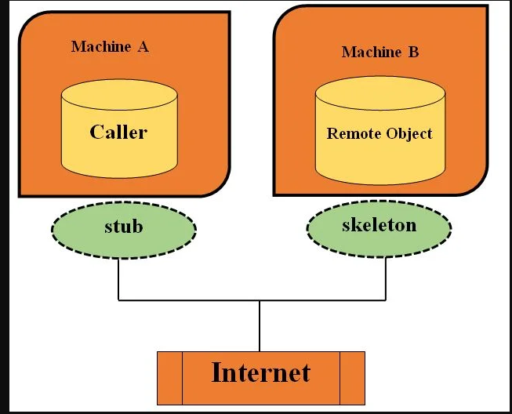
Implementation of RMI in JAVA: Stub & Skeleton

Slide 36
Implementation of RMI in JAVA: Stub and Skeleton
Stub act as a gateway for Client program.
It resides on Client side and communicate with Skeleton object.
It establish the connection between remote object and transmit request to it.
Skeleton object resides on server program. It is responsible for passing request from Stub to remote object.

Slide 37
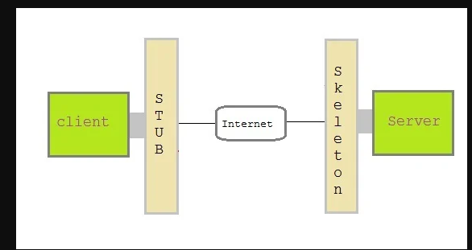
Implementation of RMI in JAVA: Stub and Skeleton

Slide 38
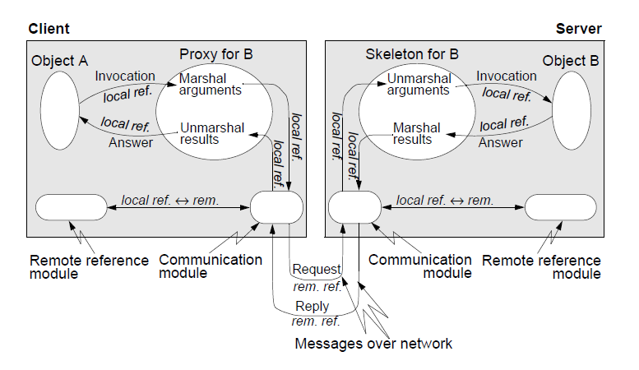
Implementation of RMI

Slide 39
Implementation of RMI
Object A and Object B belong to the application.
Remote reference module and communication module belong to middleware.
The proxy for B and the skeleton for B represent the so called RMI software.
They are situated at the border between middleware and application and are generated automatically with help of available tools that are delivered together with the middleware software.

Slide 40
Creating a Simple RMI application
It involves following steps:
Define a remote interface.
Implementing remote interface.
create and start remote application
create and start client application

Slide 41
Creating a Simple RMI application: Define a remote interface
A remote interface specifies the methods that can be invoked remotely by a client.
Clients program communicate to remote interfaces, not to classes implementing it.
To be a remote interface, a interface must extend the Remote interface of java.rmi package.

Slide 42
Creating a Simple RMI application: Define a remote interface
import java.rmi.*;
public interface AddServerInterface extends Remote
{
public int sum(int a,int b);
}

Slide 43
Creating a Simple RMI application: Implementation of remote interface
For implementation of remote interface, a class must either extend UnicastRemoteObject or use exportObject() method of UnicastRemoteObject class.
import java.rmi.*;
import java.rmi.server.*;
public class Adder extends UnicastRemoteObject implements AddServerInterface
{
Adder()throws RemoteException{
super();
}
public int sum(int a,int b)
{
return a+b;
}
}

Slide 44
Creating a Simple RMI application: create and start remote application
You need to create a server application and host rmi service Adder in it.
This is done using rebind() method of java.rmi.Naming class.
rebind() method take two arguments, first represent the name of the object reference and second argument is reference to instance of Adder
java.rmi.Naming class contains a method to bind, unbind or rebind names with a remote object present at the remote registry. This class is also used to get the reference of the object present at remote registries or the list of name associated with this registry.
RMI registry is a namespace on which all server objects are placed. Each time the server creates an object, it registers this object with the RMIregistry (using bind() or reBind() methods). These are registered using a unique name known as bind name.
To invoke a remote object, the client needs a reference of that object. At that time, the client fetches the object from the registry using its bind name (using lookup() method).

Slide 45
Creating a Simple RMI application: create and start remote application
Create AddServer and host rmi service
import java.rmi.*;
import java.rmi.registry.*;
public class AddServer {
public static void main(String args[]) {
try {
AddServerInterface addService=new Adder();
Naming.rebind("AddService",addService); //addService object is hosted with name AddService
}
catch(Exception e) {
System.out.println(e);
}
}
}

Slide 46
Creating a Simple RMI application: create and start client application
Client application contains a java program that invokes the lookup() method of the Naming class.
This method accepts one argument, the rmi URL and returns a reference to an object of type AddServerInterface.
All remote method invocation is done on this object.

Slide 47
Creating a Simple RMI application: create and start client application
import java.rmi.*;
public class Client {
public static void main(String args[]) {
try{
AddServerInterface st = (AddServerInterface)Naming.lookup("rmi://"+args[0]+"/AddService");
System.out.println(st.sum(25,8));
}
catch(Exception e) {
System.out.println(e);
}
}
}

Slide 48
Creating a Simple RMI application: Steps to run this RMI application
Save all the above java file into a directory and name it as "rmi“
compile all the java files by the command
javac *.java
Start RMI registry by the command
start rmiregistry
Run Server file by the command
java AddServer
Run Client file in another command prompt and pass local host port number at run time
java Client 127.0.0.1

